Slide 1
Covid-19 Hotspot Detection
Restaurant and Bars
Aviral Bhatnagar 10/15/2021

Slide 2
Problem Statement
Objective:
Modeling the effectiveness of Covid-19 policies by leveraging an Infection Transfer Model
Comparing the magnitude of infection spread between actual and hypothetical scenarios
Evaluating Hypothetical Scenarios
Input:
Data on stochastic visits of people per hour in the week of Nov 2nd- Nov 9th
Coordinates of bars and restaurants across Minneapolis
Volume of the establishments
Output:
New infections generated that week for every restaurant and bar considered in the study
Constraints:
Considered a constant value for Ventilation Rate
Considered a constant height for each establishment

Slide 3
Methodology
Extracted data on visits by hour for each establishment across Minneapolis
Filtered out only those establishments that fell in the category:
Restaurants and other eating areas
Bars
Joined the result with the Geometry dataset to calculate volume
Used point of interest dataset to do a spatial join with the original dataset.
Applied Wells-Riley Equation to predict the number of new infections generated in each establishment that week
Evaluated hypothetical scenarios using Inferential Statistics

Slide 4
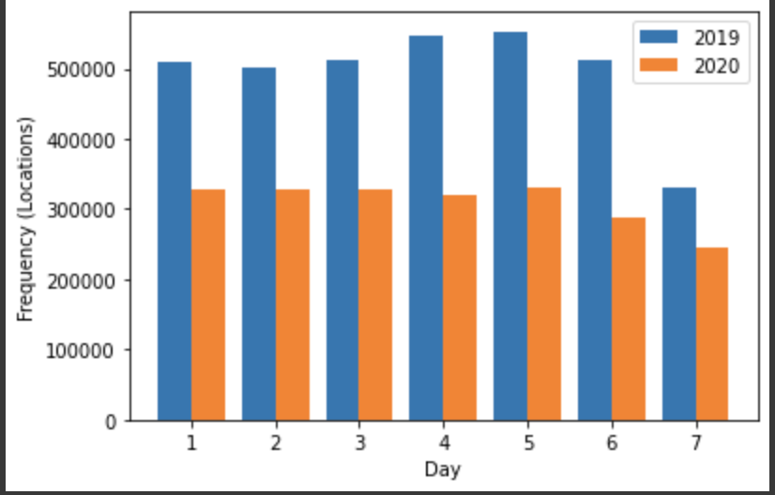
Volume of Visits in 2019 vs 2020 (1st week of November)

Slide 5
Parameters
Time Slot- November 2nd - 9th
Location: Minneapolis
Establishments: Bars and Restaurants
Ventilation Rate: (ac/h) 4
Average volume: ($m^{3}$) SafeGraph Geometry Data

Slide 6
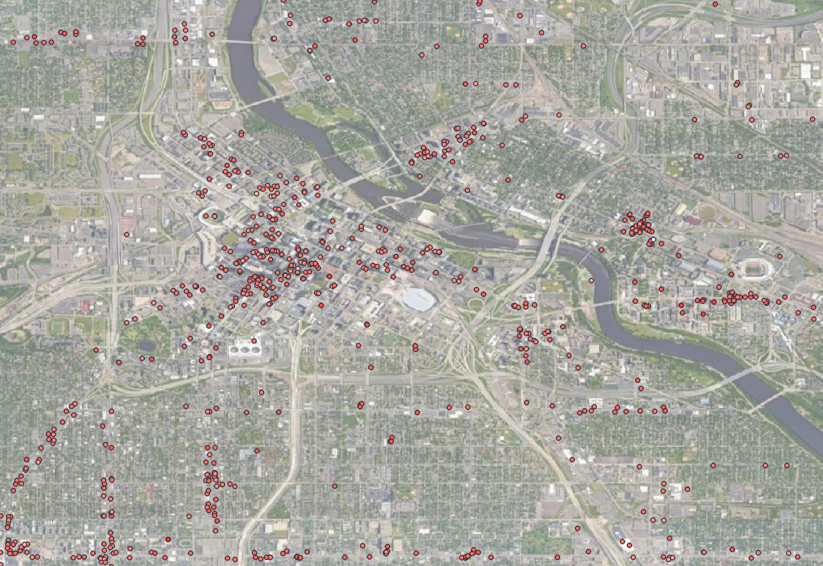
New Infections from November 2nd-9th 2020
Restaurants and Bars
Most establishments did not contribute towards more than 1 new infections
9 out of 1034 establishments had more than 1 new infection spread during the week (Severe cases)
The venue with the highest infection spread had more than 10 new infections

Slide 7
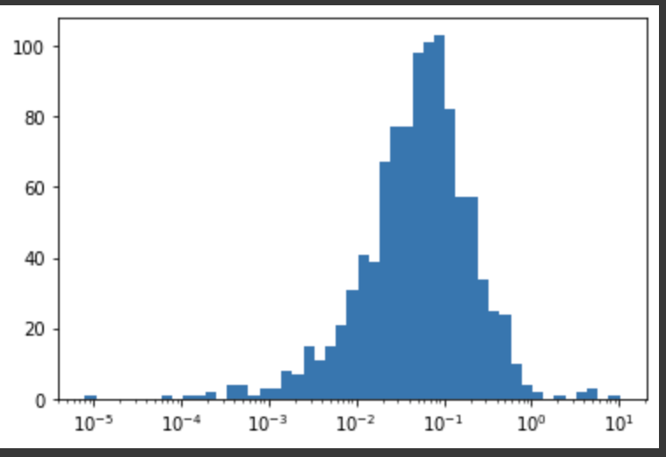
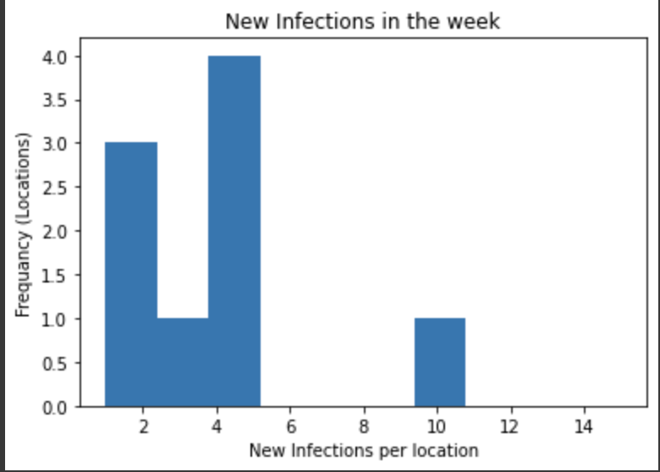
Histograms
With Stay at Home Orders
The first histogram reflects the occurrence of infections on a log scale
The second histogram represents severe cases ( >1)

Slide 8
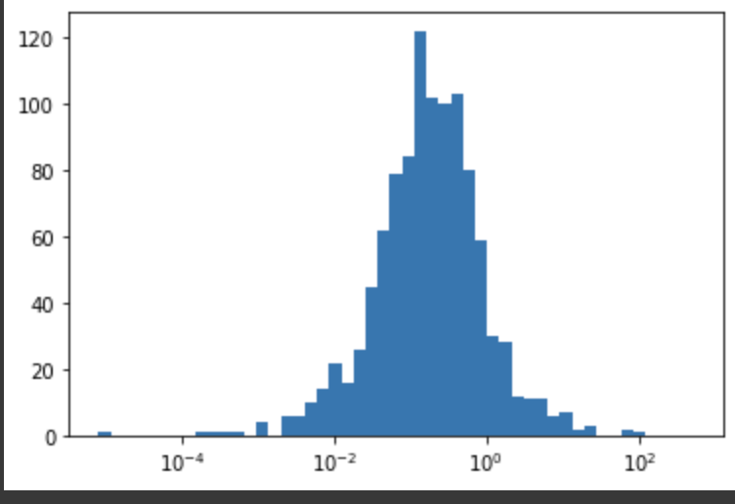
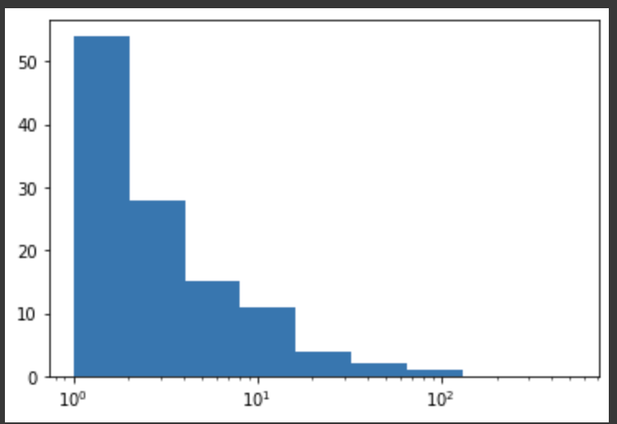
Histograms
Without Stay at Home Orders
The first histogram reflects the occurrence of infections on a log scale
The second histogram represents severe cases ( >1)

Slide 9
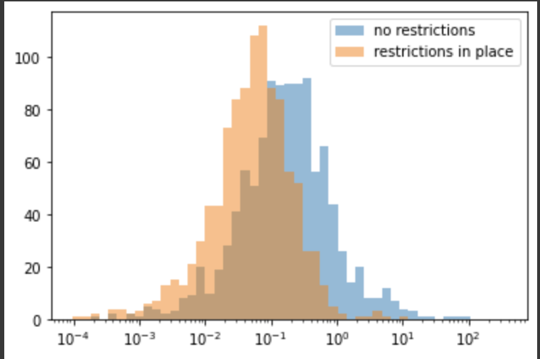
Histograms
Comparison
The histogram without restrictions show a slightly higher median of infections.
The histogram without restrictions has a slightly higher right skew due to severe infections

Slide 10
2 Sample T-Test
Comparison
P-value = 0.0068
There’s a 0.6% chance that the difference in the infection rates occurred due to a random chance.
With 99% confidence level, we can say that the difference is significant.

Slide 11
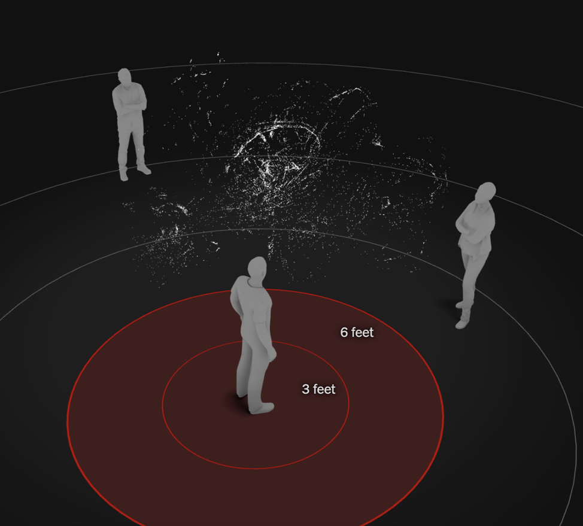
Hypothetical Scenario ( 6 ft Social Distancing )
Restricting visits based on the volume of the establishment.

Slide 12
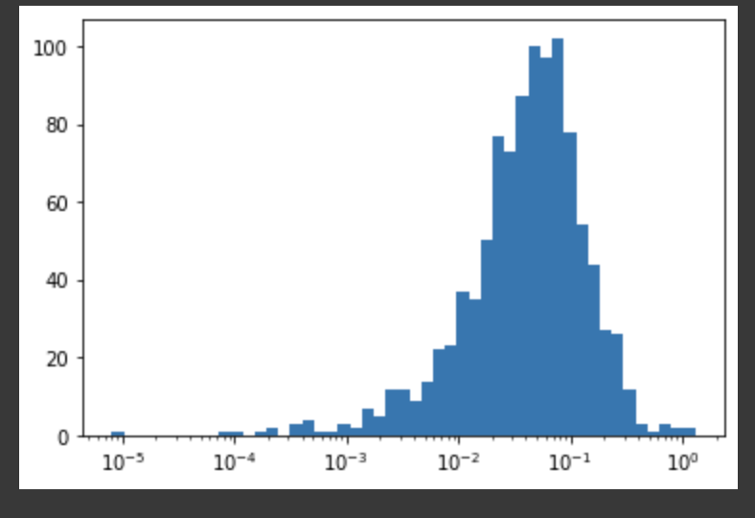
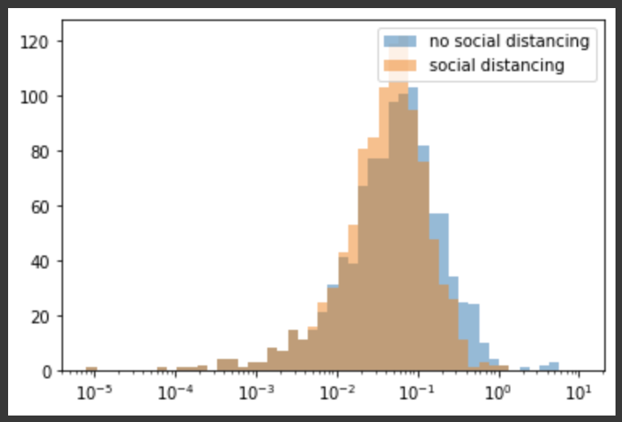
Hypothetical Scenario ( 6 ft Social Distancing )
Comparison
Only 2 venues contributed to more than one new infection during the entire week
About 1.29 new infections were generated from the most infected venue

Slide 13
Results Summary
With restrictions in place:
only 9 venues contributed to more than one new infection during the entire week.
10 new infections were generated from the most infected venue
Hypothetical scenario: (with restrictions and social distancing)
2 venues contributed to more than one new infection during the entire week
A little over 1 new infection was generated from the most infected venue
Hypothetical scenario: (without restrictions)
116 venues contributed to more than one new infection during the entire week
524 new infections were generated from the most infected venue

Slide 14
Limitations
Sparsity in our Data Set
Choosing the most ideal timeframe after considering certain factors
Tackling selection bias while choosing the right prevalence rate
Implemented the model with the assumption that all venues remain operational 24/7
Used static values for ventilation rate and ceiling height for all the venues

Slide 15
Future Work
Address Limitations with more comprehensive data and different strategies
Enhancing system flexibility by incorporating different models to address factors such as:
Vaccination Rates
Mask mandates and their rate of adherence
Effect of surging new variants on infection spread ( eg: Delta variant )
Collaborate with Himanshu Kharkwal to incorporate these features

